Slide 1
Asp.Net MVC
A new “pluggable” web framework

Slide 2
Agenda
MVC and Asp.Net
The Model, the View and the Controller
HtmlHelper and PartialView
Routing
Filters
TDD with Asp.Net MVC

Slide 3
MVC and Asp.Net
From WebForm to MVC

Slide 4
Asp.Net
Asp.Net was introduced in 2002 (.Net 1.0)
It was a big improvement from the “spaghetti code” that came with Asp classic
It introduced a new programming model, based on Events, Server-side Controls and “stateful” Form (Session, Cache, ViewState): the RAD/VB-like development model for the web.
It allowed a lot of developers to deal with the Web, also if they have limited or no skills at all in HTML and JavaScript.
Build with productivity in mind

Slide 5
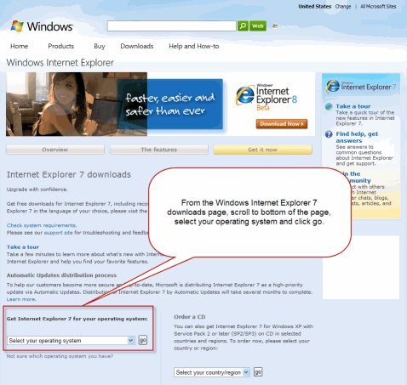
Web Form models
HttpRequest
Serialize/
Deserialize
Webform state
Code
HttpResponse
Server

Slide 6
Events and State management are not HTTP concepts (you need a quite big structure to manage them)
The page life cycle, with all the events handler, can become really complicated and also delicate (easy to break)
You have low control over the HTML code generated
The complex Unique ID values for the server-side controls don’t fit well with Javascript functions
There is a fake feeling of separation of concerns with the Asp.Net’s code behind
Automated test could be challenging.

Slide 7
The Web development today is
Web standards
HTTP
CSS
Javascript
REST (Representational State Transfer), represents an application in terms of resources, instead of SOAP, the Asp.Net web service base technology
Agile and TDD

Slide 8

So… Welcome, Asp.Net MVC
WEB

Slide 9
Asp.Net MVC “tenets”
Be extensible, maintainable and flexible
Be testable
Have a tight control over HTML and HTTP
Use convention over configuration
Separation of concerns

Slide 10
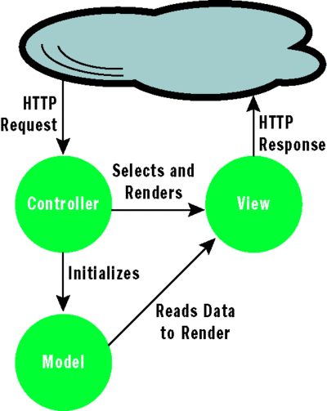
The MVC pattern

Slide 11
Separation of concerns
Separation of concerns comes naturally with MVC
Controller knows how to handle a request, that a View exist, and how to use the Model (no more)
Model doesn’t know anything about a View
View doesn’t know there is a Controller

Slide 12
Asp.Net > Asp.Net MVC
Based on the .Net platform (quite straightforward ☺ )
Master page
Forms authentication
Membership and Role providers
Profiles
Cache
Asp.Net MVC is built on (the best part of) Asp.Net

Slide 13
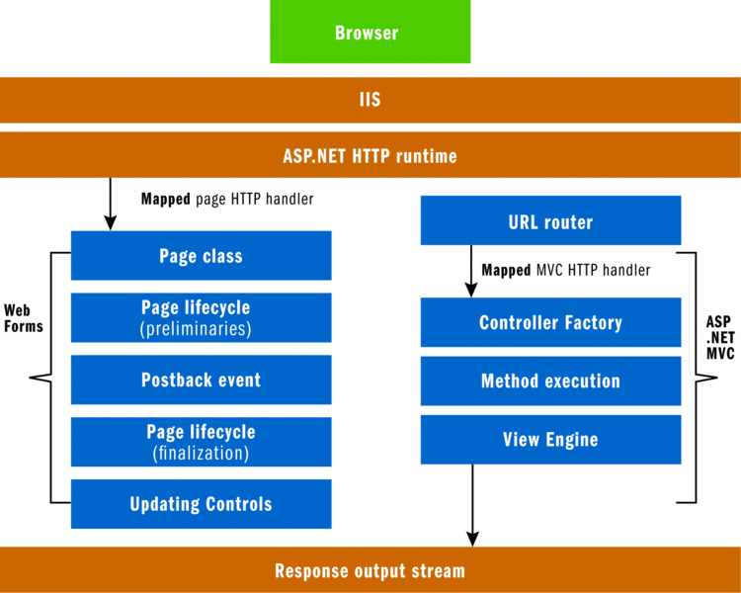
Asp.Net and Asp.Net MVC run-time stack

Slide 14
Demo
First Asp.Net MVC application

Slide 15
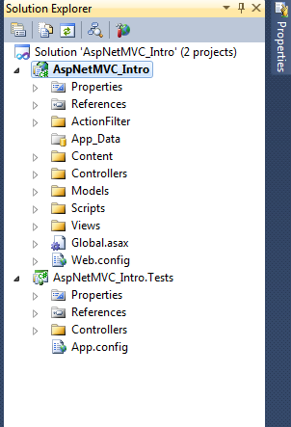
Asp.Net MVC
The structure of the project

Slide 16
Convention over configuration
Asp.Net MVC projects have some top-level (and core) directories that you don’t need to setup in the config:
Controllers, where you put the classes that handle the request
Models, where you put the classes that deal with data
Views, where you put the UI template files
Scripts, where you put Javascript library files and scripts (.js)
Content, where you put CSS and image files, and so on
App_Data, where you put data files

Slide 17
Models, Controllers and Views

Slide 18
The Models
Classes that represent your application data
Contain all the business, validation, and data acccess logic required by your application
The representation of our data

Slide 19
The Controllers
The controllers are responsible for responding to the user request
Have to implement at least the IController interface, but better if you use the ControllerBase or the Controller abstract classes (with more API and resources, like the ControllerContext and the ViewData, to build your own Controller)

Slide 20
The Action Methods
All the public methods of a Controller class become Action methods, which are callable through an HTTP request
Actually, only the public methods according to the defined Routes can be called

Slide 21
ActionResult types
EmptyResult
ContentResult
JsonResult
RedirectResult
RedirectToRouteResult
ViewResult
PartialViewResult
FileResult
FilePathResult
FileContentResult
FileStreamResult
JavaScriptResult
Asp.Net MVC has several types to help handle the response

Slide 22
Demo
Asp.Net MVC Controllers

Slide 23
The Views
The Views are responsible for providing the User Interface (UI) to the user
The View receive a reference to a Model and it transforms the data in a format ready to be presented

Slide 24
Demo
Views, Strongly Typed View, specify a View

Slide 25
What is MVC?
Request
Controller
Step 1
Incoming request routed to Controller

Slide 26

What is MVC?
Controller
Model
Step 2
Controller processes request and creates presentation Model

Slide 27

What is MVC?
Controller
View
Step 3
Model is passed to View

Slide 28

What is MVC?
Controller
View
Step 4
View transforms Model into appropriate output format

Slide 29
What is MVC?
Controller
View
Response
Step 5
Response is rendered

Slide 30
Html Helpers
Html.TextBox
Html.ActionLink, RouteLink
Html.BeginForm
Html.Hidden
Html.DropDownList
Html.ListBox
Html.Password
Html.RadioButton
Html.Partial, RenderPartial
Html.Action, RenderAction
Html.TextArea
Html.ValidationMessage
Html.ValidationSummary
Methods shipped with Asp.Net MVC that help to deal with the HTML code.
MVC2 introduced also the strongly typed Helpers, that allow to use Model properties using a Lambda expression instead of a simple string

Slide 31
Routing
Routing in Asp.Net MVC are used to:
Match incoming requests and maps them to a Controller action
Construct an outgoing URLs that correspond to Contrller action
How Asp.Net MVC manages the URL

Slide 32
Defining Routes
public static void RegisterRoutes(RouteCollection routes)
{
routes.IgnoreRoute("{resource}.axd/{*pathInfo}");
routes.MapRoute(
"Default", // Route name
"{controller}/{action}/{id}", // URL with parameters
new { controller = "Home", action = "Index", id = UrlParameter.Optional } // Parameter defaults );
}
protected void Application_Start()
{
AreaRegistration.RegisterAllAreas();
RegisterRoutes(RouteTable.Routes);
}
}
The default one…

Slide 33
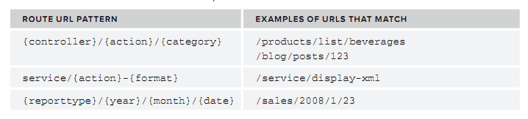
Route URL patterns

Slide 34
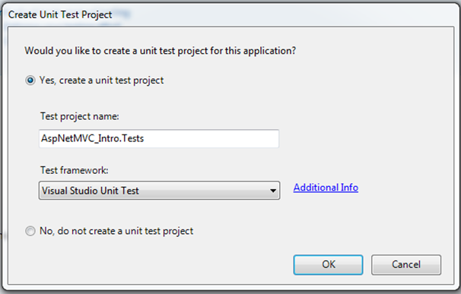
TDD with Asp.Net MVC
A framework designed with TDD in mind from the first step
You can use your favorite Test Framework
With MVC you can test the also your UI behavior (!)
Asp.Net MVC was made with TDD in mind, but you can use also without it (if you want… )

Slide 35
Demo
TDD with Asp.Net MVC

